Slide 1
Conflation classes, transitivity alternations and argument realization
Nikolas Gisborne
University of Edinburgh
China International Forum on Cognitive Linguistics
Beihang University, Beijing, May-June 2016

Slide 2
Conflation classes, transitivity alternations and argument realization
Roadmap
Conflation classes: Talmy’s typology and Levin and Rappaport Hovav’s arguments about manner/result complementarity.
Transitivity alternations: do verbs preserve their meanings in different argument configurations?
Argument realization: how do we model linking?

Slide 3
Conflation classes
Section 1

Slide 4
How do we model conflation classes?
Levin and Rappaport Hovav: ‘manner’ verbs are incompatible with lexicalized ‘results’.
Talmy: there is a typological split between verb-framed and satellite-framed languages.
Talmy’s categories involve the non-conflation of path and manner.
English is satellite-framed: path is (usually) expressed by a P: run into, go out, fall down—this is a Germanic pattern.
Spanish is verb framed: ENTRAR (‘go in’) SALIR (‘go out’) SUBIR (‘go up’) BAJAR (‘go down’)—typical Romance pattern.

Slide 5
Talmy’s typological split
Spanish therefore conflates motion and path, but excludes manner.
English conflates motion and manner, but excludes path.
If a Spanish speaker wants to express a manner, then they would use a participle to say something like he entered running:
entró corriendo ‘he entered running’.

Slide 6
Levin and Rappaport Hovav
CLEAR vs. WIPE (1991) [Manner and result are in complementary distribution].
BREAK vs. HIT (2005)
The boy broke the window with a ball.
The boy hit the window with a ball.
But:
The window broke.
*The window hit.
In our terms, this cannot be because only BREAK has a further subevent: as we have seen, HIT includes 2 subevents in its sense.

Slide 7
Levin and Rappaport Hovav
So how come?
L&RH argue that BREAK is a Result verb: that is, it involves a causative network in its lexical structure (in my terms, not theirs).
BREAK verbs: BEND, FOLD, SHATTER, CRACK.
HIT verbs: SLAP, STRIKE, BUMP, STROKE.
BREAK verbs participate in the causative-inchoative alternation: he broke the stick—the stick broke.

Slide 8
Levin and Rappaport Hovav
HIT verbs do not go into the causative—inchoative alternation.
But they do go through the Body Part Ascension structure, which BREAK verbs do not.
I broke his leg/*I broke him on the leg.
I hit his leg/I hit him on the leg.
Croft (2012): HIT and BREAK have the same force-dynamic structure: boy→ball→window

Slide 9
Rappaport Hovav and Levin (2010)
Rappaport Hovav and Levin (2010) go on to develop a theory of manner-result complementarity.
In their terms, manner verbs cannot be part of a causative network.
Verbs that are part of a causative network cannot include manner information.
Cf. RH&L (2010: 21) ‘results involve scalar changes while manners involve nonscalar changes. We propose a verb may only lexicalize one type of change, giving rise to manner/result complementarity’.

Slide 10
Rappaport Hovav and Levin (2010:25-26)
There is a generalization implicit in the canonical realization rules in (7)–(11), which leads us to formulate a lexicalization constraint.
(12) The lexicalization constraint: A root can only be associated with one primitive predicate in an event schema, as either an argument or a modifier.
This constraint is similar in spirit to the constraint with the same name in (13) proposed by Kiparsky (1997) in a study of denominal verbs, in that semantic roles are often taken to be labels for positions in an event schema (Jackendoff 1972).
(13) The lexicalization constraint: A verb can inherently express at most one semantic role (theme, instrument, direction, manner, path). (Kiparsky 1997:30)

Slide 11
Rappaport Hovav and Levin (2010: 24)

Slide 12
Rappaport Hovav and Levin (2010: 26)
‘Assuming the event schemas of (7)–(11), and assuming that manner roots modify the predicate ACT and result roots are arguments of BECOME, a root can modify ACT or be an argument of BECOME in a given event schema. A root cannot modify both these predicates at once without violating the lexicalization constraint. Thus, there can be no root which expresses both manner and result, and manner/result complementarity follows’.

Slide 13
‘Roots’
An aside: as I said in the previous lecture…
The verb ‘root’ in RH&L’s theory is its core meaning; they have also called it a constant.
Note that it can appear in two positions in their event structure:
As a modifier of an action
As a result state
What does it mean for it to occur in these two positions?
In WG, the meaning of a verb is defined as a position in a network.
And in the case of an Action, ‘jogging’ Isa Action. We don’t say that ‘jogging’ modifies action. How would that work?

Slide 14
Rappaport Hovav and Levin 2010
Is result associated with telicity?
No!
Degree achievements are result verbs, but they have both telic and atelic uses.
The chemist cooled the solution for three minutes.
The chemist cooled the solution in three minutes; it was now at the desired temperature.
Neither is basic. And some telic verbs are not result verbs.

Slide 15
What is scalar change?
WARM and COOL
They warmed the milk.
They cooled the drinks.
Each of these verbs involves a scale but they go in different directions.
‘We suggest that the relevant attribute whose values make up the scale is the location of a theme with respect to a ‘ground’—a reference object. In the motion domain, the predicates which lexicalize such scalar attributes without a notion of change are prepositions like above, below, far, and near, which also locate a theme with respect to a ground (Jackendoff 1983; Talmy 1983; Vandeloise 1991)’ (RH&L 2010: 29).

Slide 16
What is scalar change?
A scalar change can have a multi-point scale or a two-point scale.
ARRIVE and CRACK are both two-point scale verbs.
Multiple point scale verbs include ADVANCE and DESCEND; the scales can be closed (EMPTY) or open (LENGTHEN).
Paths, and telic meaning elements introduce scales.

Slide 17
What are non-scalar changes?
Activities, like JOG, FLAP, FLUTTER.
These are activities in terms of their Aktionsart.
They are changes because they are dynamic.
And they are non-scalar because the changes are just temporary changes in their Er.
They work rather like the diagram of GALLOP.

Slide 18
How does this work with the event hierarchy?

Slide 19
Event hierarchy
With the version of the event hierarchy presented in the previous lecture, it doesn’t work very well.
But with the event hierarchy for activities, perhaps we can make more sense of the dichotomy.
The scalar properties that RH & L discuss can be accommodated with a combination of the result attribute, and the model of stages that we can draw on from Holmes’ analysis of GALLOP.

Slide 20
Activities

Slide 21
Activities
The diagram on the previous page splits active verbs into two kinds right at the top of the hierarchy:
Those that have a manner attribute.
And those that have a result attribute.
By including stage information with both of these classes of verb, we can include and describe the scalar information that RH & L discuss.
See the next diagram (Holmes 2005).

Slide 22
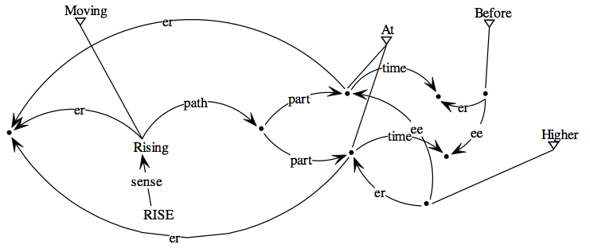
RISE (Holmes 2005: 171)

Slide 23
RISE
Holmes’ diagram includes information which can be understood as a scale, as defined by Rappaport Hovav and Levin (2010).
The path which RISE lexicalizes is defined as having parts.
And those parts are defined as being traversed in a temporal sequence.
RISE is like DESCEND—a multiple point scale verb.

Slide 24
Activities
RH&L’s claim can be reduced to the height on the inheritance tree: the division into manner vs. result verbs takes place right at the top of the tree.
Except that their “result” includes paths and telic aspect, so it is more general than WG’s result.
They also make the argument that there is a complexity constraint: conflating manner and result in a single verb would give rise to a great deal of information complexity.
And what about counterexamples?

Slide 25
Counterexamples and counterarguments
The main counterexamples would be verbs like CLIMB and CUT. RH&L argue that these verbs do not lexicalize both manner and result.They have different senses which lexicalize one or the other of manner and result.
Goldberg 2010 (same volume as RH&L) argues against manner/result complementarity. Her argument comes from verbs such as FRY.
Beavers and Koontz-Garboden 2012.
Goldberg also argues against RH&Ls’ templatic approach in favour of an approach which explores the lexical meanings of verbs in different construction frames.
What about ELECTROCUTE? Or SCATTER:
He scattered the almonds into the cake batter

Slide 26
Talmy
Where does this leave Talmy’s theory of lexicalization patterns?
Talmy makes a typlogical claim.
For him it’s not verbs but languages that are event or satellite framed.
That’s not quite right: English has verb-framed-event denoting verbs such as ENTER (borrowed from Romance) despite being satellite-framed.
English also has the non-borrowed COME, GO, BRING and TAKE.

Slide 27
Talmy
As Croft (2012: 294) summarizes it, Talmy distinguishes between
Manner-incorporating type languages
English: He ran into the cave
Path-incorporating type languages
Spanish: Entró corriendo a la cuevo
Ground-incorporating type languages
Atsugewi: ′-w> uh- st’aq’ –ik <-ª
<3sg.fact> by.gravity lie.runny.icky.material on.ground ‘runny icky material (e.g. guts) is lying on the ground’

Slide 28
Talmy
In addition, Talmy’s typology has been extended by Slobin to include equipollent languages.
Talmy (2000) updates his framework to talk about framing.
Framing is a generalized concept of a result state. It includes notions such as path and telic aspect.
It therefore corresponds to RH&L’s result.
Therefore Spanish is a verb-framing language, and English is a satellite-framing language

Slide 29
Talmy
Croft (2012: 296): ‘It is clear that Talmy and Levin and Rappaport Hovav are describing the same broad lexical semantic contrast in terms of the lexicalization of event structure in simple verbs.’
So is it better to understand these differences in terms of typology or of lexical semantics?
It seems best to do this in terms of lexical semantics. Languages can be of a mixed type, largely as part of their verbstock changing

Slide 30
Manner/result—how to evaluate the claims
There are various theoretical ways to approach the claims about manner result complementarity.
The most obvious one is to explore the claims about conflation, and scalarity, in terms of a theory which allows them to be evaluated.
But another one is to look at a language from a diachronic perspective. Languages have changed from one type to the other
Latin was satellite-framed. Modern Romance is verb-framed. What happened in the middle?

Slide 31
Transitivity alternations
Section 2

Slide 32
Transitivity alternations
How do we model the transitivity alternations?
Give him a book.
Give a book to him.
Jane opened the door.
The door opened.
The door is open.
Ali hit Foreman.
Foreman hit at Ali.
Ali hit Foreman on the face.
Helen wiped the fingerprints off the wall.
Helen wiped the wall.

Slide 33
Transitivity alternations
The WG answer is that part of the network for one sense can be found in the network of the other sense.
We saw this with the analysis of OPEN which I gave in one of the first lectures.
There are two different verbs that mean OPEN, and an adjective.
They each map onto a different part of the associative network.

Slide 34
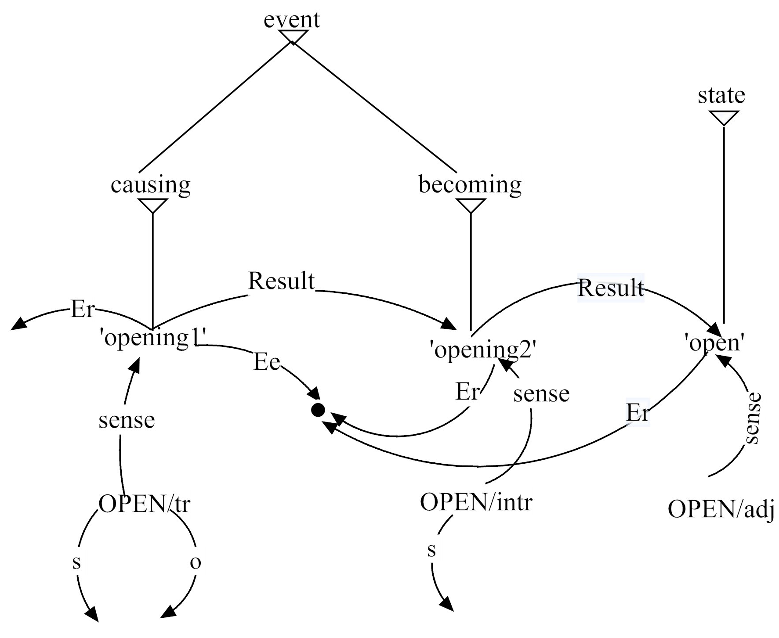
OPEN

Slide 35
OPEN
Transitivity alternations involve just two different properties:
Polysemy
Collocation
Either the two variants in a transitivity alternation are just two different senses of the same item,
Or the item collocates with other sentence elements.

Slide 36
Collocation
Collocation is a very simple idea:
I ate a ′hotdog [sausage] vs.
!I ate a hot ′dog [canine friend]
Eating the item in (1) makes sense. Eating the item in (2) does not.
Some predicates cannot collocate with other sentence elements.
You can look at the picture but you can’t listen at the music.

Slide 37
Collocation
We can look at the body-part ascension “alternation” in terms of collocation.
Jane hit Peter on the nose.
Jane broke Peter on the nose.
HIT can collocate with ON but BREAK cannot.
Why? Is there anything in their lexical structure that prevents it?
Levin (1993)’s answer was that BREAK doesn’t have a touching element in its meaning.

Slide 38
HIT, BREAK and the BPA
But that claim is very strange: when you break something, you normally touch it.
There seems to be a relationship to metonymy.
Perhaps what’s at stake is the scope of the action's effect.
If I hit you, then I inevitably hit some part of you such as your nose.
I can't break you by breaking some part of you.

Slide 39
HIT, BREAK and the BPA
Is this metonymic transitivity: if you do X to a part of Y, then you necessarily do X to Y itself?
If I hit the window, I only hit part of the window.
If I break the window, all of the window is necessarily broken.
This is about construal
The BPA is allowed where the meaning of the verb requires the action to apply to a part of the Ee-entity.

Slide 40
HIT, BREAK and the BPA
Are there examples of the BPA that clearly don’t require touching?
We need a context: parents sniff their babies—to find out if the baby needs a new nappy, and also because a freshly washed, well fed baby smells nice.
Is this ok?
I smelt the baby on her head.
Smelling does not involve touching.

Slide 41
Polysemy and transitivity alternations
However, either way, a transitivity alternation involves either a different network, or a collocation restriction.
In the next diagram we look at the polysemy of MAKE.
MAKE has three key uses:
A transitive verb use: make a cake.
A ditransitive use: make me a cup of tea.
And an predicative complement use: make him a good man.

Slide 42
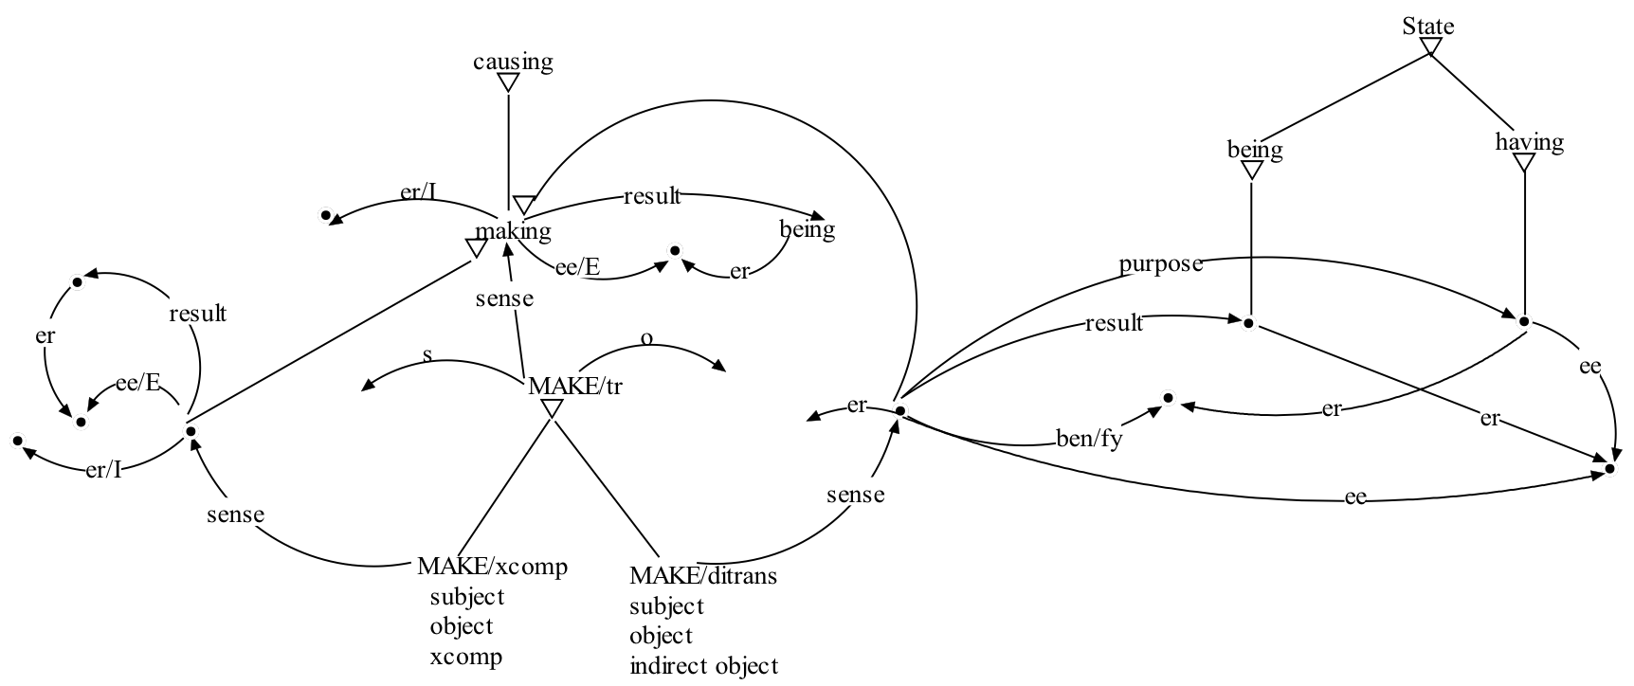
MAKE

Slide 43
MAKE
make/tr is the basic form.
The ditransitive variant and the Xcomp variant both inherit from the transitive.
The semantics of make/tr are entirely embedded in the semantics of ditransitive make, and the semantics of make/xcomp unpack and reassign the semantic structures associated with make/tr.
make/xcomp and make/ditrans inherit from make1 and their senses inherit from its sense.

Slide 44
GIVE
GIVE is also polysemous.
Give her some flowers.
Giver some flowers to her.
The double object and double complement instances of GIVE have different meanings.
This comes up in an ontological constraint on the direct object (note that these judgments vary in the context of Heave NP shift).
The scandal gave the reporter an idea.
*The scandal gave an idea to the reporter.
Bright lights give Amy migraines.
*Bright lights give migraines to Amy.

Slide 45
GIVE
The two senses of GIVE differ in terms of their result event.
Ditransitive GIVE, as we have seen, has ‘having’ as its result event.
Double complement GIVE, on the other hand, has to be compatible with the preposition: it has to collocate.
This has ‘moving’ as its result event (N.B. He denied food to all of the prisoners—the moving is overridden).

Slide 46
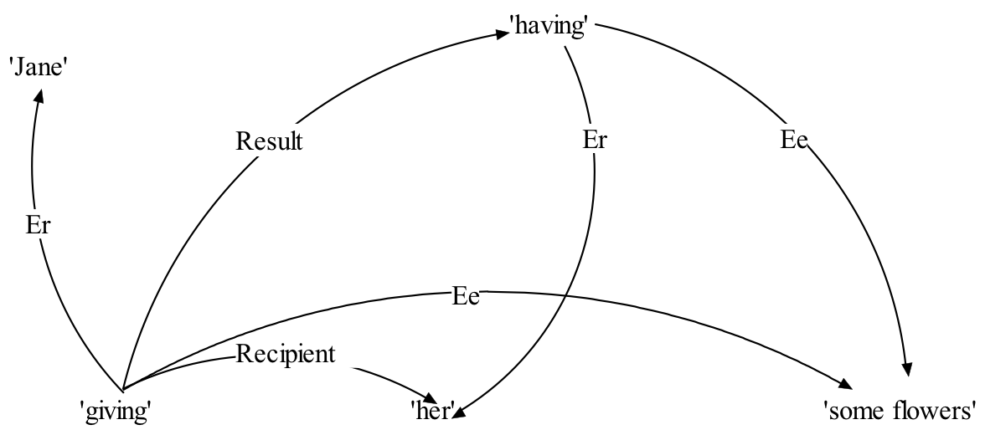
Sense of double object GIVE

Slide 47
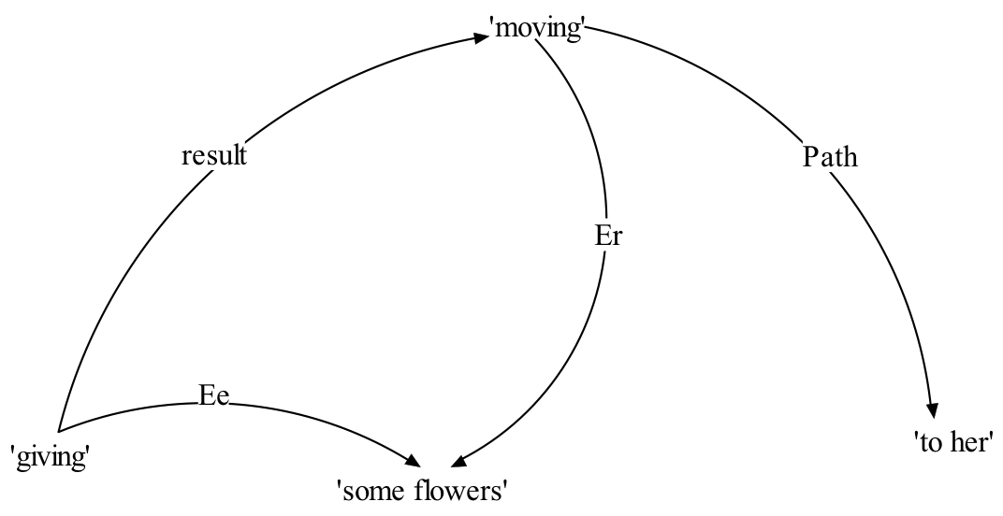
Sense of double complement GIVE

Slide 48
Explanation
The Er of ‘moving’ must be physically capable of moving.
The Ee of having does not need to be a physical thing.
This is an ontological constraint – it is a constraint on the (ontological) class of things that can be Ers and Ees.
Showing the ontological constaints is simply a matter of identifying the classification of certain nodes.
The Recipient of ‘giving’ is more restricted than the Ee of ‘giving’, so it is classed as a subtype of thing—it has to be animate (I can’t give the table a vase).

Slide 49
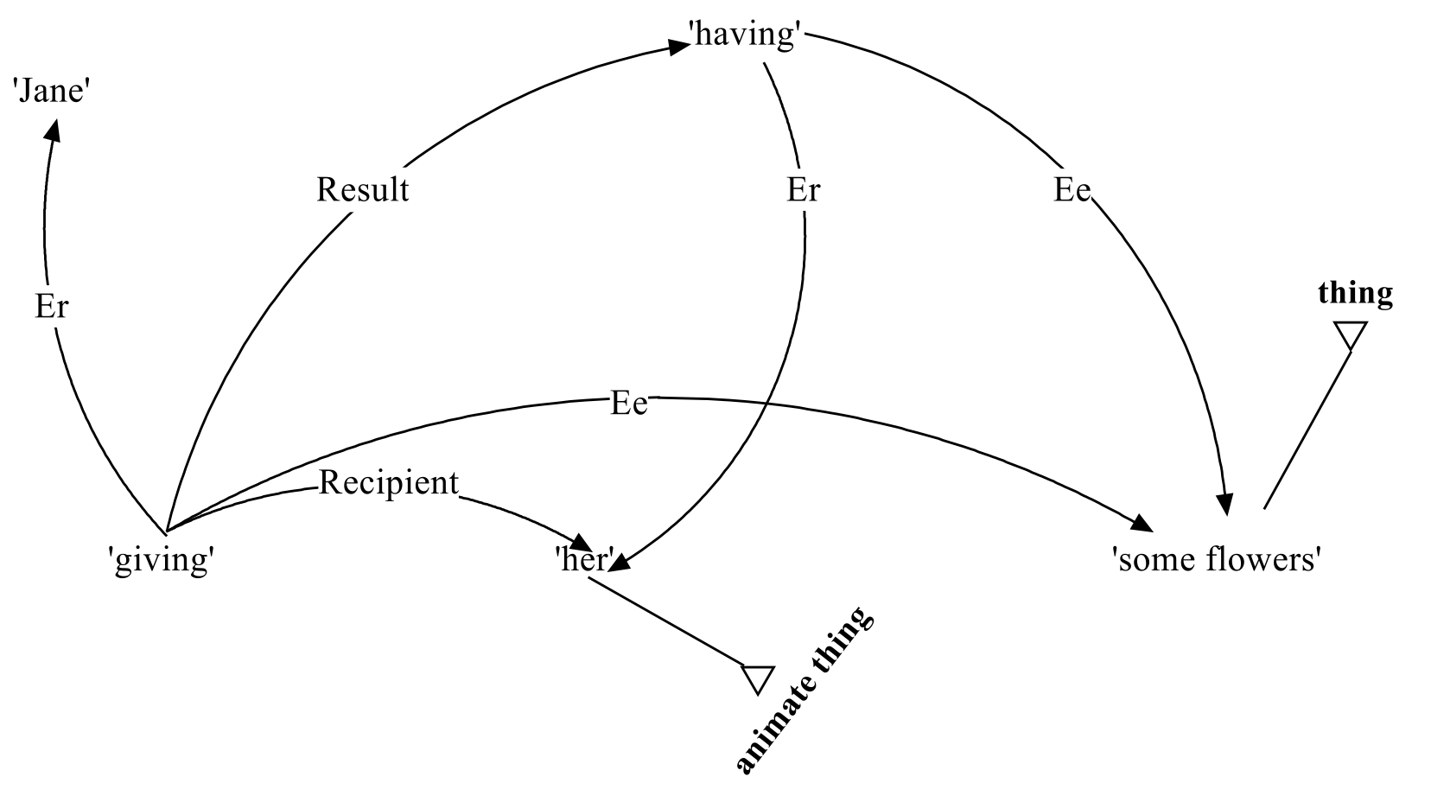
GIVE and ontological constraints

Slide 50
Explanation
The next diagram shows the ontological constraint on the double complement version of GIVE.
‘moving’ places additional restrictions on its Er.
The Er of ‘moving’ has to be something which can physically move.
Certain kinds of event select their subjects and objects, or more precisely select their subjects’ and objects’ category(ies) of meaning.

Slide 51
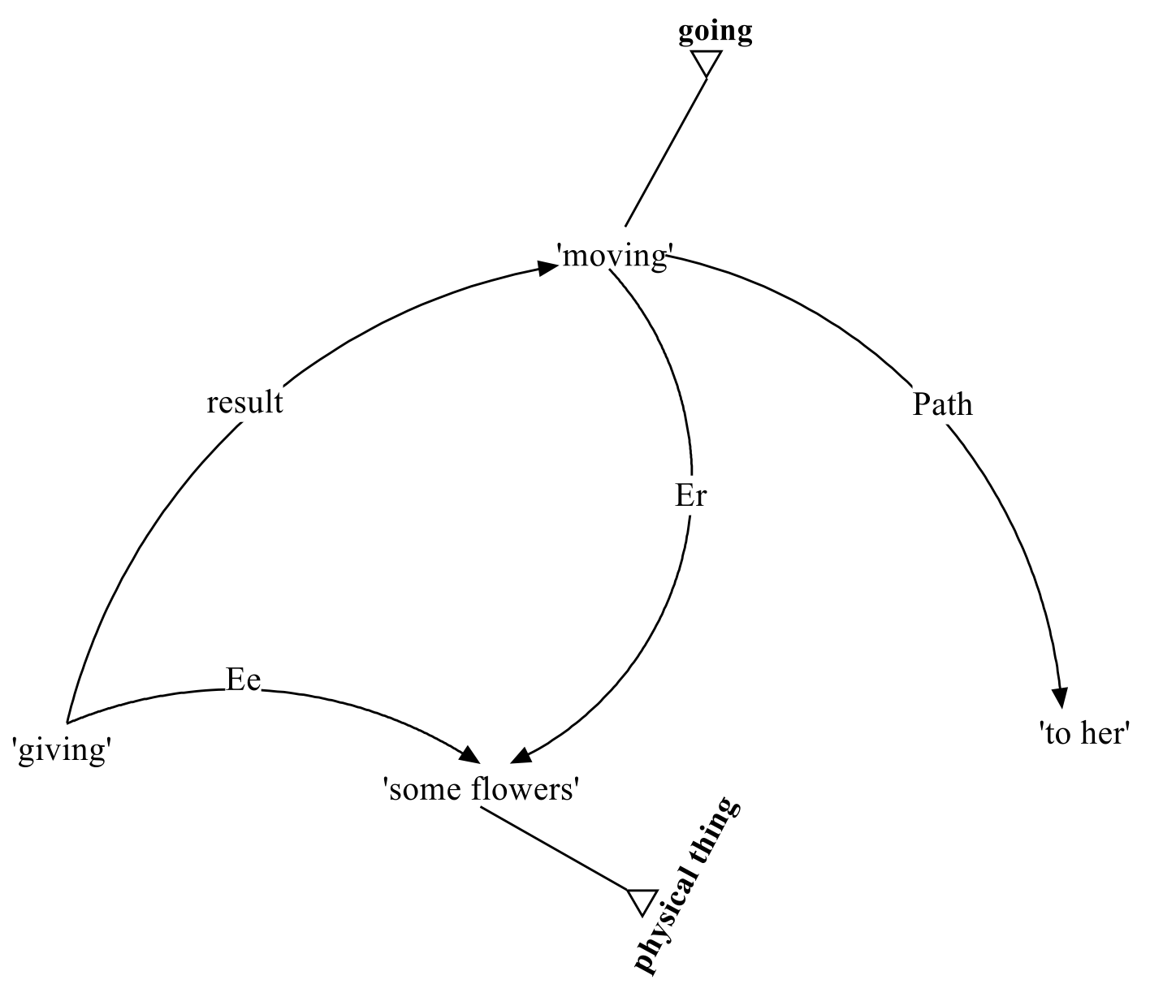
Explanation

Slide 52
More data
We can see how well the diagrams extend to further data.
Jane sent Peter a letter.
*Jane sent the PO Box a letter.
I’ve shown this before: the Recipient has to be animate.
Now here’s the rub: is it a restriction on the Recipient, or is it a restriction on the Er of ‘having’—the Er of having has to be something which is capable of possession.
Or do we really need to factor out the constraint?

Slide 53
More data
Do the representations in Figures 1 and 2 explain the following grammaticality difference?
*Break me the contract.
Break the contract for me.
The result in *break me the contract is a kind of ‘having’, but if you break something you can’t have it.
The other example is grammatical because you can add a “beneficiary” FOR phrase to any intransitive or transitive verb: dance for me; skip for me; kiss your mother for me; eat this cake for me.

Slide 54
More data
Do the representations explain the following grammaticality differences?
Jane gave Peter a present.
Jane gave Peter a kiss.
Jane gave Peter flu.
Jane gave a present to Peter.
?Jane gave a kiss to Peter.
?Jane gave flu to Peter.
Yes. Kisses and flu can’t be Ers of moving. For those people for whom these examples are grammatical, it is probably the case that the result of ‘giving’ is an instance of ‘going’ not ‘moving’.

Slide 55
Argument realization
Section 3

Slide 56
How to link arguments
How do we relate the arguments of a verb’s sense to its syntactic arguments?
What are the mechanisms?
Are there algorithms?
The answer is that there aren’t any algorithms:
Argument-linking patterns are learnt as part of learning the verb.

Slide 57
How to link arguments
But with other grammatical patterns we do learn generalizations.
So the linguist’s job is to
Establish the argument-linking patterns that they can see.
And establish the generalizations.
I said this in Lecture 5, where I talked about the meaning of the indirect object construction, and argued that it had a sense which Isa both Recipient and Beneficiary.

Slide 58
Grammatical functions have a sense

Slide 59
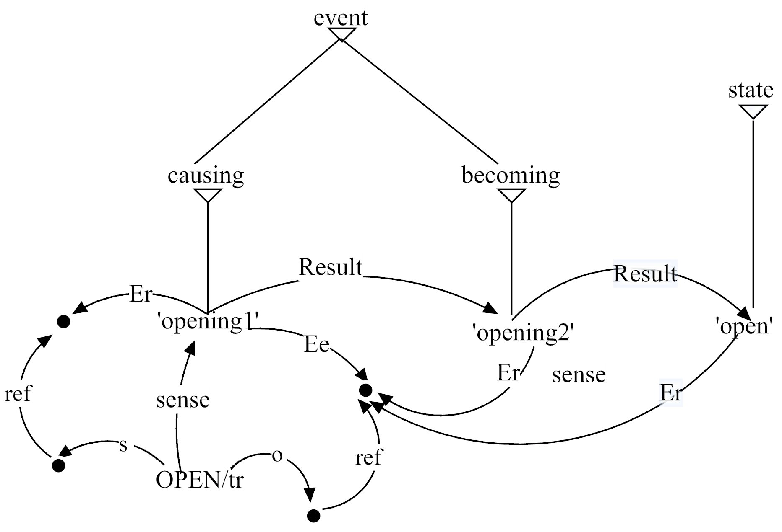
OPEN linking

Slide 60
OPEN linking
It is in argument linking that the sublexemes come into their own.
Each sense of OPEN is associated with a separate sublexeme which has a particular linking pattern.
The sense ‘opening2’ is associated with its own bit of form. This is shown in the next diagram.

Slide 61
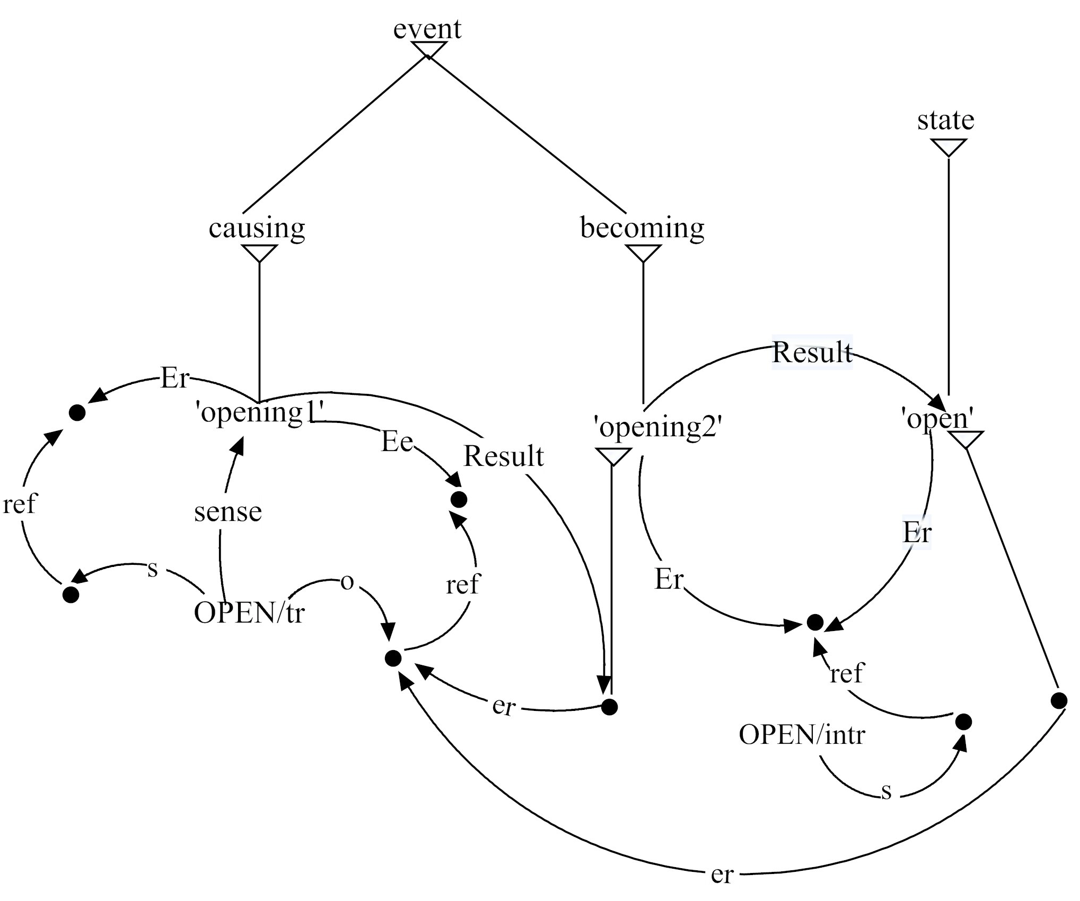
OPEN linking

Slide 62
Linking
This gives us Ers linking to to Subjects,
Ees linking to Objects,
Indirect Objects linking to Recipients/beneficiaries.
There are other patterns:
What links to predicative complements (xcomps)?
How do complement PPs combine with the meanings of verbs?
Variation within single verbs is negotiated via the sublexeme.

Slide 63
Conclusions
It is not clear that the manner/result dichotomy is settled.
But it is clear that the verb-framed vs. satellite-framed distinction is overstated: languages are not one or the other; verbs are.
Argument linking is done in the network by explicit links between the semantic relations Er and Ee to Subject and Object, etc.
And variable verb behaviour is captured by degree of distance from the verb’s prototype.

